Slide 1
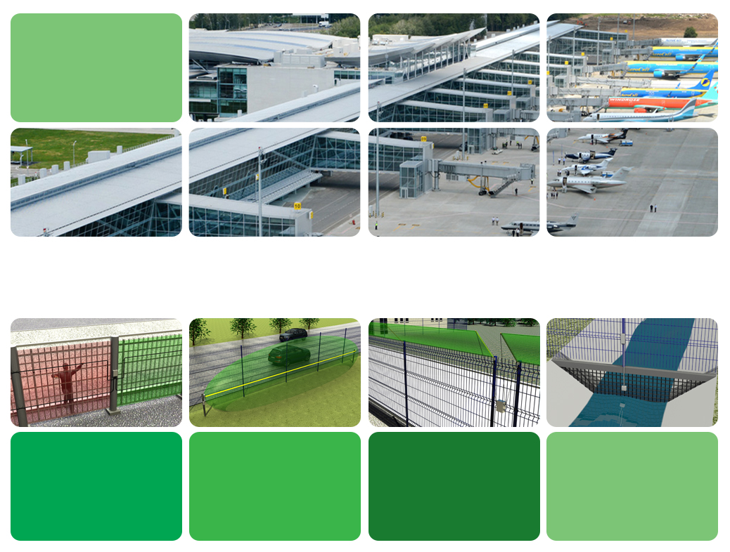
PROTECTION OF SITES USING THE ELECTRONIC SECURITY PRODUCTS SECURITY SENSOR

Slide 2
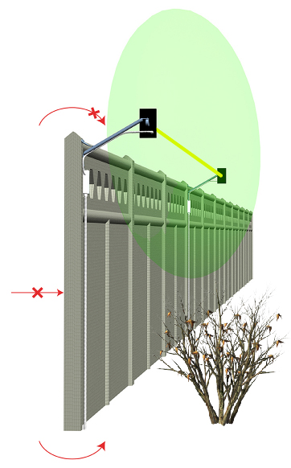
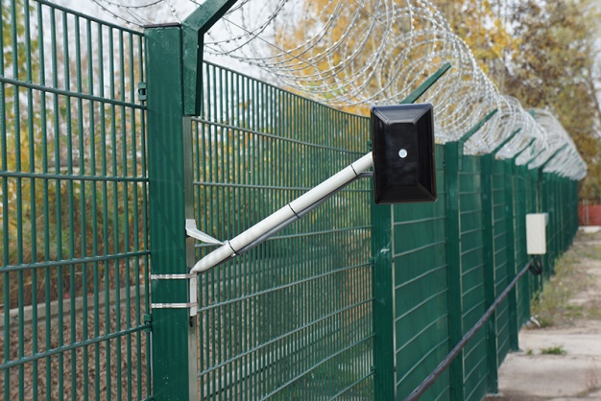
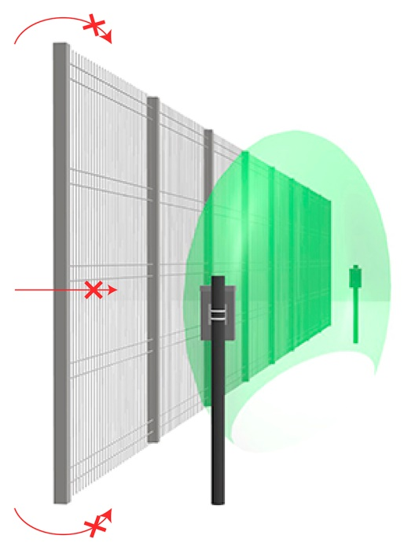
VARIANT OF PROTECTION USING
THE BISTATIC SENSORS
2
The easiest and the most reliable variant of protection of rectilinear perimeter sectors from unprepared intruder. Operation on electric power stations up to 500 kV.
Dual Technology sensors SS MIR-B are used on sites where it is impossible to provide a zone free of any moving objects and remove grass and bushes.
The sensors have increased immunity to different noise thanks to combining of two physical principles of detection: MW+IR.
Microwave sensors are used on sites:
- with a zone up to 5 m wide along the perimeter free of any moving objects;
- where it is possible to remove grass and bushes;
- without landscape irregularities more than 0,3 m.
www.security-sensor.com

Slide 3
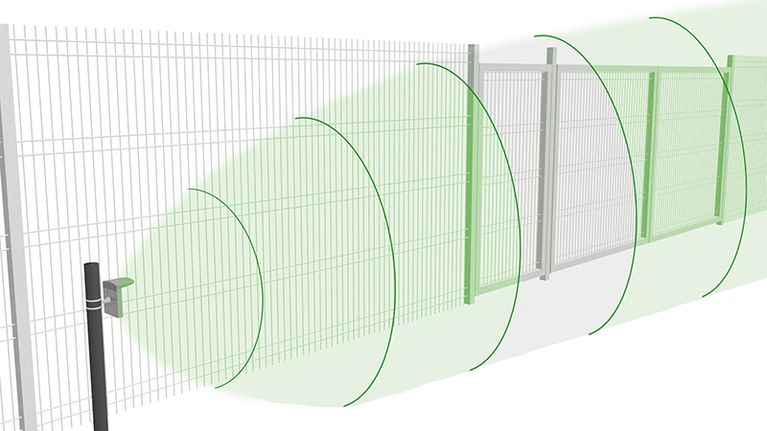
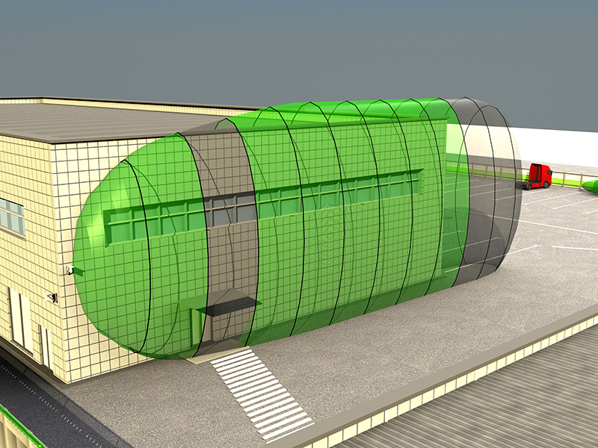
VARIANT OF PROTECTION USING
MONOSTATIC SENSORS
3
Protection of separate perimeter sectors like blind alleys, ravines, warehouse grounds, places where the communication routes cross the perimeter, tunnels, overpass bridges and any other sites where it is impossible to use bistatic sensors.
The sensor feature is the detection zone containing 12 sub-zones which can be controlled while configuring.
We previewed the possibility to deactivate any sub-zones, for example, to make a secured passage to let people and transport move through.
www.security-sensor.com

Slide 4
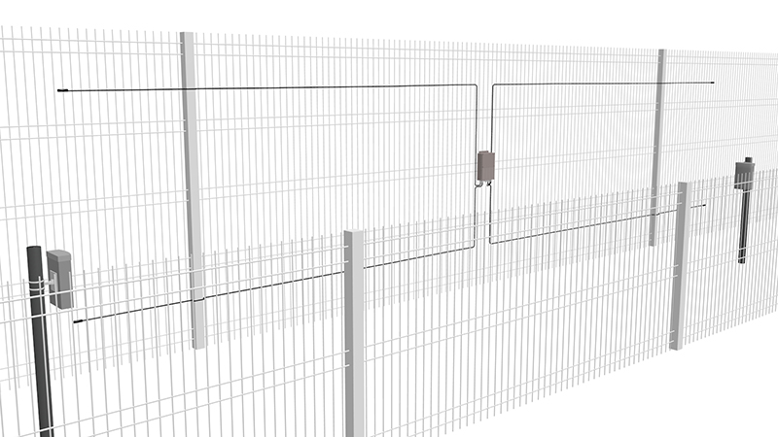
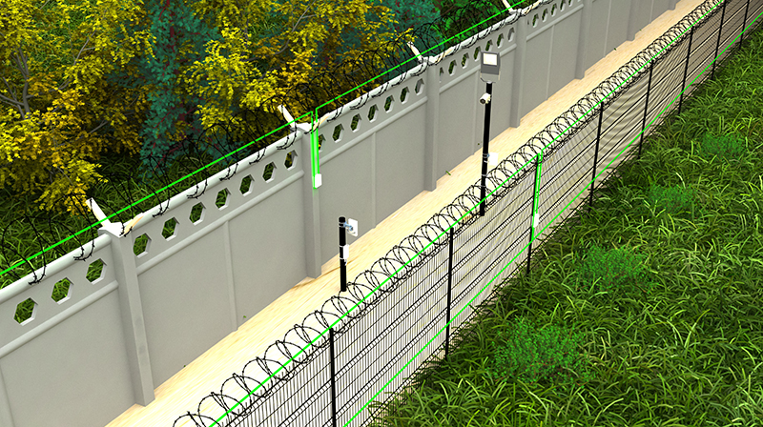
VARIANT OF TWO BOUNDARY PROTECTION
4
Is used to secure sensitive sites. We use sensors operating on different principles and located in different places.
This variant assures the best detection of the intruder and makes him significantly more difficult to cross the protected zone. Put additional fence not to let small animals move within the detection zone and to decrease the number of false alarms. The additional fence also holds the intruder within the detection zone and gives time to the guard group to come.
www.security-sensor.com

Slide 5
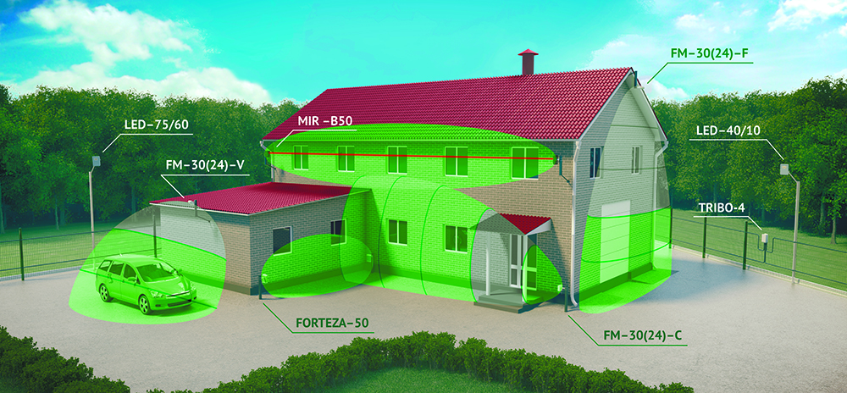
PROTECTION OF A WAREHOUSE
5
The task – to detect the intrusion to the protected territory and inside the object. The condition – there are dogs on the territory, and it is not possible to remove snow.
SS -30 (24) - F
SS -30 (24) - V
SS M50
SS -30 (24) - C
The solution – we use the sensor TRIBO-4 to protect the perimeter 450 m long using one kit. The security lighting is installed along the fence, it works on 30% in stand-by mode and on 100% in case of alarm.
The rest of sensors protect the building from intrusion through windows and doors.
www.security-sensor.com

Slide 6
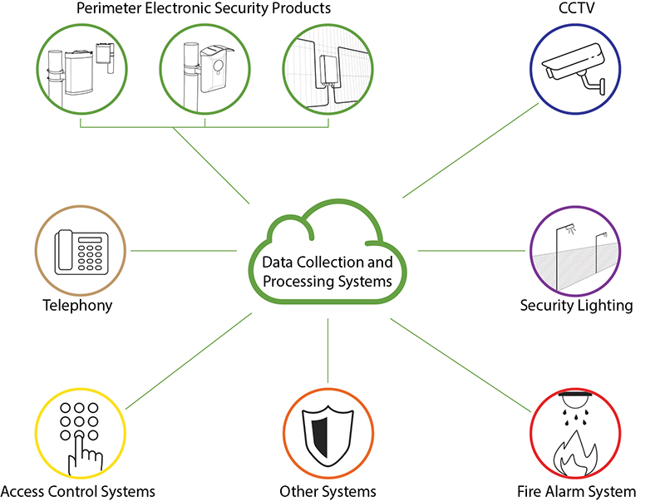
INTEGRATION WITH OTHER SYSTEMS
6
The integration is assured by integrated systems on the base of control panels or on the base of the PC using the software. The integration joins the operation of different systems, for example, the perimeter sensors with the security lighting or video surveillance. Like this we can activate the lighting and display the picture from the camera in case of the sensor triggering.
It is possible to connect TM SS equipment in two ways: 1. Using the relay contacts. In this case the system will receive only the alarm signals from the sensors. 2. Using the interface RS-485. In this case the system will receive all information on the state of the sensors and will allow to configure the sensors remotely.
www.security –sensor.com

Slide 7
Contacts
7
THANK YOU FOR YOUR ATTENTION!
YOU ARE WELCOME TO ASK QUESTIONS… + 1 786 906 07 84 info@security-sensor.com www.security-sensor.com

